Slide 1
ONLINE SHOPPERS PURCHASING INTENTION ANALYSIS
Krischelle Joyner
University of Texas at San Antonio
Data Analytics Applications

Slide 2
Background | 03
Motivation | 04
Description of Data | 06
Data Processing | 07
Proposed Analysis | 08
Data Exploration | 09
Results | 15
Conclusion | 18
Recommendations | 19
References | 20
Presentation Outline

Slide 3
Background
Online Shoppers Purchasing Intention
As the majority of businesses today operate online, marketing promotion is one of the most effective ways to drive traffic to an online virtual ecosystem. As visitors browse a website, the most relevant users are identified, and can be connected with offers that will encourage them to return to a store after they have left, avoiding the high probability of losing customers after they leave.
Marketing data is becoming a powerful tool for companies to not only understand what products customers are interested in, but to also explore some of the reasons why a product is not purchased. The goal of using marketing data is to identify the underlying patterns of behavior.

Slide 4
Motivation
What makes this data set interesting?
The motivation for using this dataset is to understand visitors' shopping intent. A growing number of people search for items to buy online and make purchases through online transactions; this has made their lives more convenient and easier. Yet sellers must also be aware of the patterns and intentions of different types of online visitors. Customer behavior insights can help sellers to target advertising, marketing, and deals to potential customers to further increase their sales and revenue. Specifically, I am interested in purchases as an indicator of good marketing on products. The analysis will primarily focus on:
Which factors heavily influenced visitors to purchase an item?
Using Revenue as the dependent variable (TRUE – made a purchase, FALSE – did not make a purchase), I will explore 18 independent variables such as bounce rate, the type of visitor and several other characteristics to see which variables worked best for indicating a purchase.

Slide 5
Motivation
Hypothetical Research Questions
01
02
03
04
How long does a visitor stay on a page? Understanding the attention span for most individuals is very important when thinking about the layout of the page and number of steps it takes from visiting the site to making a purchase. I can get a better idea of this by viewing the average page time per visitor.
What type of pages does the customer visit? This behavior can help to understand if the customer knew what they were shopping for initially, or were browsing and open to other items as well.
How many visitors are repeat customers? Future marketing campaigns can benefit greatly from knowing the type of visitor on the site.
Are customers more likely to buy on or around holidays? If this is the case, stores would have more incentive to change prices around high demand periods.

Slide 6
Description of the Data
Data
The data set consists of feature vectors from 12,330 sessions. Each session was allocated to a unique user within a 1-year window in order to avoid a tendency toward a specific campaign, special day, or user profile. Within the dataset, 84.5% of sessions (10,422) were examples of negative classes that did not end with shopping, while the remaining 15.5% (1,908) were examples of positive classes that did end with shopping.
The data was gathered a few different ways. The page type and duration were gathered from the URL, while the remaining variables, other than Special Day, were gathered from Google Analytics.
The three different page types, Administrative, Informational, and Product Related information were derived from the URL information of the pages the user visited and updated in real time when the user took action. The duration for each of these page types was calculated in hours by month.

Slide 7
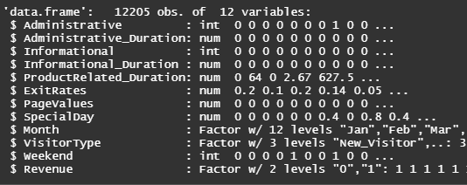
Data Processing
I changed the Weekend variable to an integer, and the following variables to factors as they have multiple classes: OperatingSystems, Browser, Region, TrafficType, VisitorType, Revenue, and Month.
I noticed a correlation between the “BounceRates” and “ExitRates” variables, so I removed the “BounceRates” variable from the dataset. I also noticed a correlation between the “ProductRelated” and “ProductRelated_Duration” variables, so I removed the “ProductRelated” variable from the dataset.
I removed the following variables as the numbers do not have good references for the outcomes: OperatingSystems, Browser, Region, TrafficType.
I performed the following tasks to pre-process and clean the data, and adjust for its limitations.
I removed 125 duplicate records from the data set leaving a total of 12205 records.
As far as the data quality is concerned, there were no missing data points to remove.

Slide 8
Proposed Analysis
Models
Logistic Regression
Random Forest
Naïve Bayes
The online shopper's intent dataset will be analyzed using logistic regression, random forest, and naive bayes models, and include visual representations of the data analysis to aid in the interpretation of the results. These are great models since the features are categorical.
No cross-validation
5-fold cross validation
5-fold repeated cross validation.
Tree-based method
Independent classifiers

Slide 9
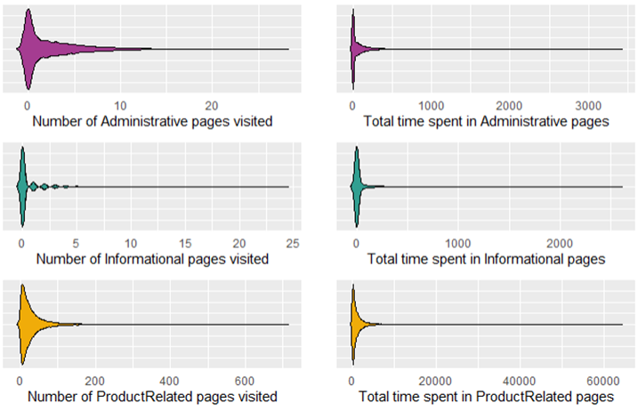
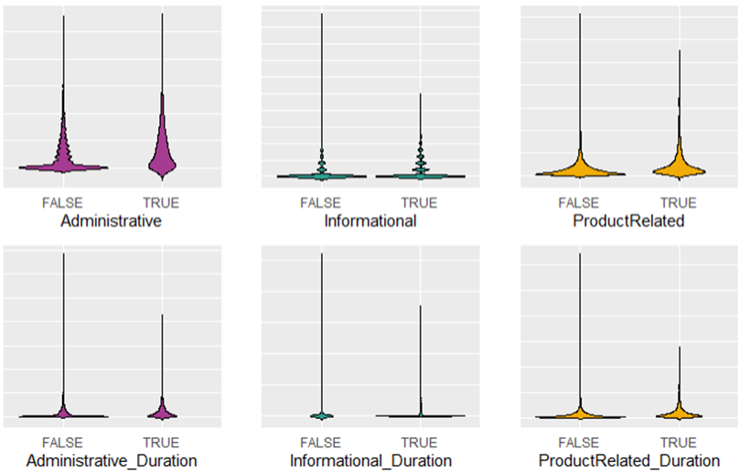
Exploratory Analysis
Types of Pages and Duration
Median # of pages visited
Administrative pages: 1
Informational pages: 0
ProductRelated pages: 18
Median time spent on pages
Administrative pages: 9
Informational pages: 0
ProductRelated pages: 608.9
It is surprising that most of the customers who completed transactions spent more time browsing Administrative and ProductRelated pages than Informational pages, since this indicates that they are loyal customers who checked out after adding items to their carts.

Slide 10
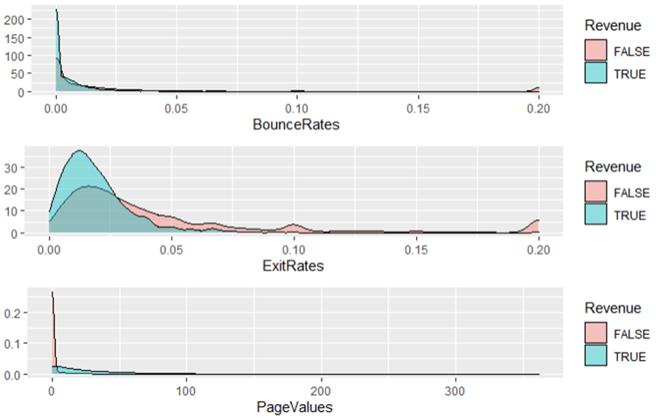
Exploratory Analysis
BounceRates, ExitRates, and PageValues
BounceRates, ExitRates, and PageValues provide insights into the behavior of customers viewing pages. There doesn't appear to be a significant difference in revenue when examining customers' BounceRates. On the other hand, when looking at ExitRates, the plot shows that customers who bought an item are in general less likely to leave than customers who did not buy an item, since they spent more time on the pages. The Pagevalues of non-purchasing customers are much lower than those of purchasing customers because they spend less time on related pages.

Slide 11
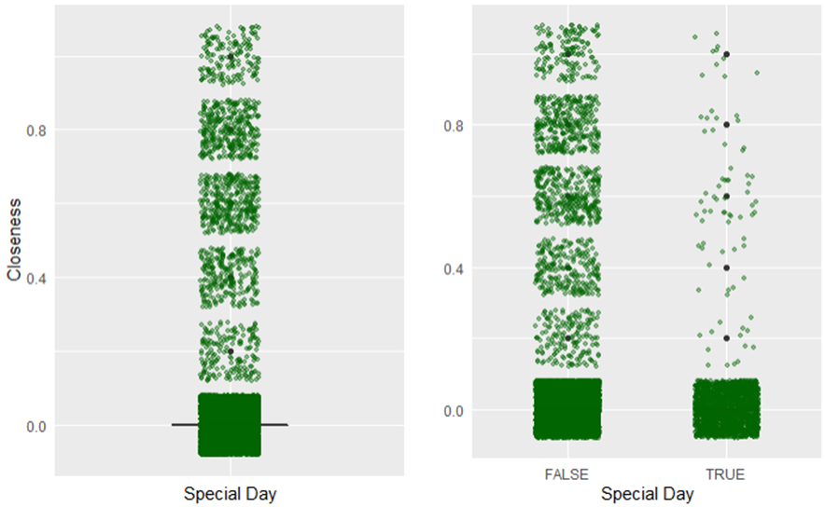
Exploratory Analysis
Special Day
On non-special days, purchasing customers were more likely to make purchases. This supports my observation that most customer decisions are not influenced by whether it is a special day or not.

Slide 12
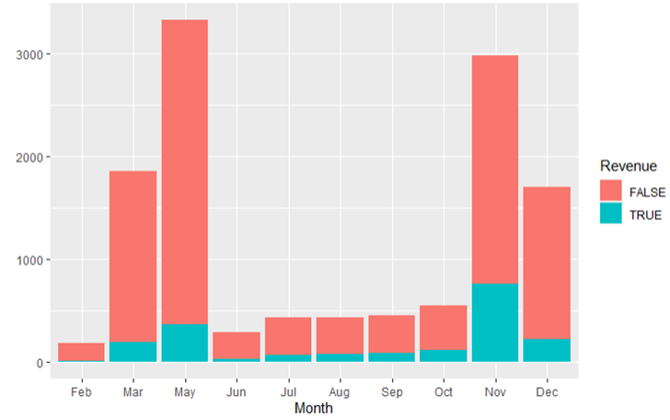
Exploratory Analysis
Month
It should be noted that the month attribute displays only 10 of the 12 months, excluding January and April. The majority of shopping took place during March, May, November, and December. This might be due to these months being right before a new season.

Slide 13
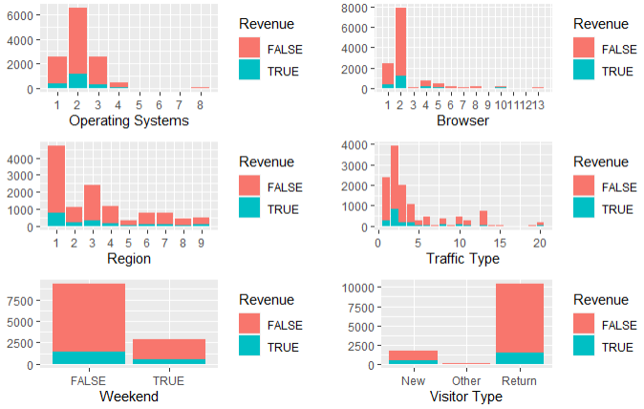
Exploratory Analysis
Operating Systems, Browser, Region, Traffic Type, Weekend, Visitor Type
Without knowing the numbers, the Operating Systems, Browser, Region, and Traffic Type attributes are not much help. The Weekend attribute shows more purchases on weekdays, while the Visitor Type is mostly return customers.

Slide 14
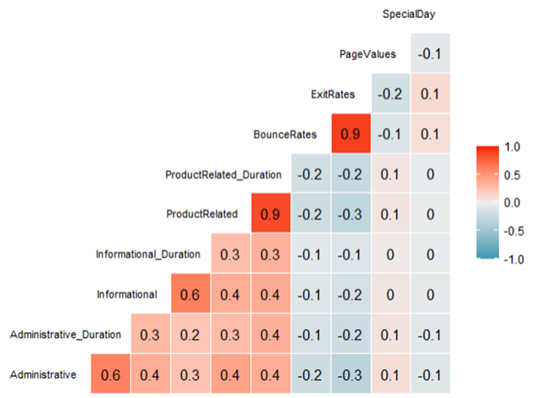
Exploratory Analysis
Correlations
I looked at the correlations among variables in the data set. I see several high-correlated pairs like BounceRates/ExitRates and ProductRelated/ProductRelated_Duration that are evident; one of each pair might be dropped because of its importance to our model.

Slide 15
Results
Variable Importance (Most to Least important)
Logistic Regression PageValues, ExitRates, MonthNov, ProductRelated_Duration, VisitorTypeReturning_Visitor, MonthJul, MonthAug
Random Forest PageValues, ExitRates, ProductRelated_Duration, Administrative, MonthNov, Administrative_Duration, VisitorTypeReturning_Visitor
Naïve Bayes Naive Bayes classifiers do not offer an intrinsic method for evaluating feature importance. Instead, they compute the conditional and unconditional probabilities associated with the features and predict the class with the highest likelihood.

Slide 16
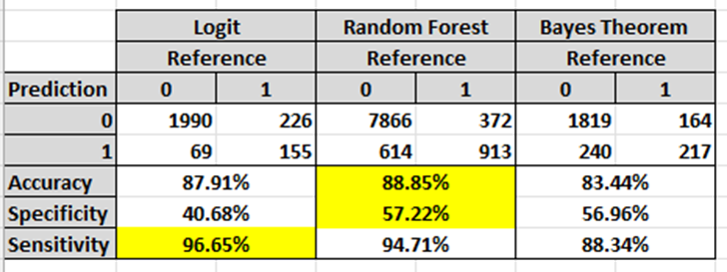
Results
Accuracy
Accuracy The differences in accuracy are close, but the Random Forest model performed the best with 88.85%.

Slide 17
Results
Specificity and Sensitivity
Specificity and Sensitivity It is apparent that the Sensitivity percentages are high for all three models and the Specificity is low. It seems to be a cause of unbalanced data. If you remember, 84.5% of the sessions contained in the dataset (10,422) do not end with shopping, while the remaining 15.5% (1,908) ended with shopping which creates this imbalance. This is because the model guesses no shopping on most occurrences and is correct.
Since my final model will be the Random Forest model, I’ll go into the details for Specificity and Sensitivity. The sensitivity is 94.7% and the specificity is 57.2%. This model will correctly identify 94.7% of the visitors who did not make a purchase, but it will also fail to identify 5.3%. The model will correctly identify 57.2% visitors who made a purchase, but it will also identify 42.8% of visitors as making a purchase when they will not. These numbers aren’t looking very good, indicating the importance of balancing data.

Slide 18
Conclusion
The dataset gives us a lot of insights into how consumers behave. It is important to remember that our generalizations can sometimes
be inaccurate based on our day-to-day experiences. The major takeaways from ‘Online Shoppers Purchasing Intent’ are the following:
01
How long does a visitor stay on a page? The page values and exit rate variables show how important certain pages are in completing a purchase.
What types of pages does the customer visit? The type of pages reviewed the longest were administrative and related products.
02
03
How many visitors are repeat customers? The majority of purchases came from our loyal customers.
Are customers more likely to buy on or around holidays? The popular times to buy were not holidays, or special days, but rather the month of November.
04

Slide 19
Recommendations
Recommendation 1
This data set suffers from unbalanced data, so if anyone wants to use it in the future, I suggest that they fix that when they clean the data.
Recommendation 2
Each of the three models works well for classification data. They were all close in prediction percentages, and they are efficient to train and easy to interpret. I would recommend using them in future classification problems.

Slide 20
References
References
1
Multilayer Perception Sakar, C. Okan, S. Olcay Polat, Mete Katircioglu, and Yomi Kastro. “Real-Time Prediction of Online Shoppers’ Purchasing Intention Using Multilayer Perceptron and LSTM Recurrent Neural Networks.” Neural Computing and Applications 31, no. 10 (October 2019): 6893–6908. https://doi.org/10.1007/s00521-018-3523-0.
Random Forest Baati K., Mohsil M. (2020) Real-Time Prediction of Online Shoppers’ Purchasing Intention Using Random Forest. In: Maglogiannis I., Iliadis L., Pimenidis E. (eds) Artificial Intelligence Applications and Innovations. AIAI 2020. IFIP Advances in Information and Communication Technology, vol 583. Springer, Cham. https://doi.org/10.1007/978-3-030-49161-1_4
3
2
Online Shopping Liu, Yuming. Online Shoppers Purchasing Intention. https://rstudio-pubs-static.s3.amazonaws.com/588410_b71a2f1ad47c4eafa145c424f4fc0faf.html.
4
UCI Data set UCI Machine Learning Repository: Online Shoppers Purchasing Intention Dataset Data set. (n.d.). Retrieved December 5, 2021, from https://archive.ics.uci.edu/ml/datasets/Online+Shoppers+Purchasing+Intention+Dataset.

Slide 21
THANK YOU !
ONLINE SHOPPERS PURCHASING INTENTION ANALYSIS
Krischelle Joyner
University of Texas at San Antonio
Data Analytics Applications

